Slide 1
Multiple Testing Dependence And Data Heterogeneity
Meilei Jiang
Department of Statistics and Operations Research

Slide 2
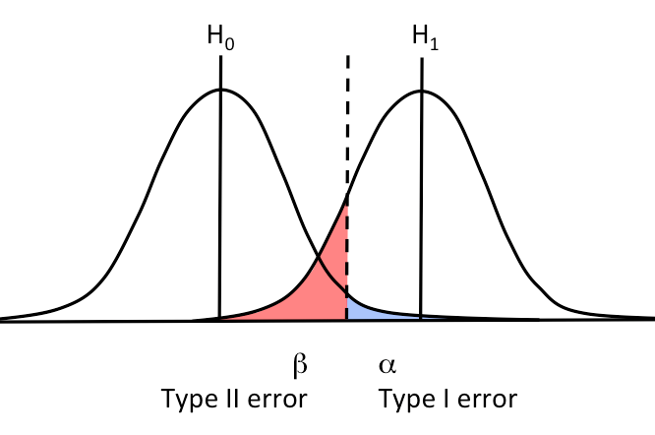
Single Test
One null hypothesis: H₀
Test statistics: Y
Corresponding p-value: P
Reject H₀ when P < α
Control the Type I as α while achieving a desirable Type II error for relevant alternatives

Slide 3
Multiple Test
A collection of null hypotheses:
H₁, H₂, …,H_{N}
Test statistics (not necessarily independent):
Y₁, Y₂, …, Y_{N}
Corresponding p-values:
P₁, P₂, …, P_{N}

Slide 4
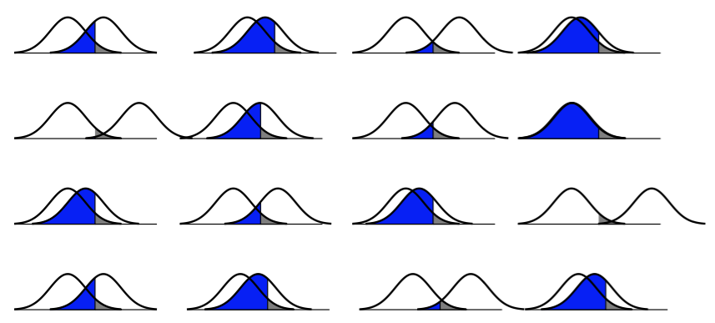
Multiple Tests, One Threshold
The probability of Type I error grows with the number of tests.

Slide 5
Multiple Test
 | Declared non-significant | Declared significant | Total
True null hypothesis | U | V | m₀
Non-true null hypothesis | T | S | m-m₀
Total | m-R | R | m
Per-Comparison Type I error (PCER): P(V_{i} > 0), i = 1, …, m
Familywise Type I Error (FWER): P(V > 0)
Bonferroni procedure: use per-comparison significance level α/m
False Discovery Rate (FDR): E(V/R)
Benjamini-Hochberg procedure

Slide 6
Benjamini-Hochberg procedure
Let P₍₁₎≤P₍₂₎≤ … ≤P_{(m)} be the ordered p-values, and denote by H_{(i)} the corresponding null hypothesis.
Let k = max{i: P_{(i)} ≤ α i /m }.
Reject H₍₁₎, H₍₂₎,…, H_{(k)}
For independent tests, the BH procedure controls the FDR ≤ α T₀ / m

Slide 7
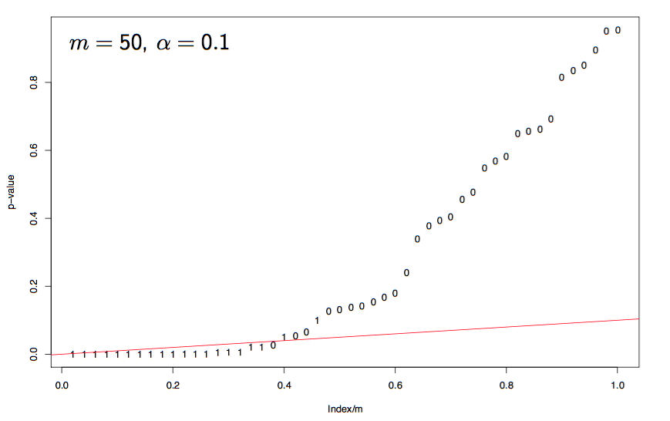
Benjamini-Hochberg procedure

Slide 8
Mixture Model for Multiple Tests
Let H₁, H₂, …,H_{N} i.i.d. Bernoulli(α)
P_{i}|H_{i} = 0 follows Uniform(0, 1)
P_{i}|H_{i} = 1 follows distribution F in the class F on [0, 1]
Under this model, the m p-values P^{m} = (P₁, …, P_{m}) are marginally i.i.d. from
G = (1-a) U + a F
0 ≤ a ≤ 1 is the frequency of alternatives.
U is the Uniform(0, 1) c.d.f.
F is a distribution of the class F

Slide 9
Multiple Testing Dependence
Benjamini and Yekutieli (2001) show that the BH procedure still control FDR on special dependence structure
A simple case is Gaussian variable with totally positive covariance matrix
Under general dependence structure, the BH procedure controls FDR at level
(Σ_{1≤i≤m}1/i) α T₀/m

Slide 10
Multiple Testing Dependence
Leek and Storey (2008) proposed a general model for multiple testing dependence
Data matrix X
m rows: m hypothesis tests
n columns: each test base on an n-vector of data sampled from a common probability space on R^{n}
Model X = B S + E = B S + Γ G + R
H_{0i}: b_{i} in Ω₀ vs H_{1i}: b_{i} in Ω₁
G is the dependence kernel.
S is the basis matrix, which is known.

Slide 11
Data Heterogeneity
Data Heterogeneity can cause multiple testing dependence and thus distorts the distribution of p-value under null hypothesis.
Spatial Dependence
Usually arising as dependence in the noise because of a structural relationship among the tests.
Latent Structure
A latent structure due to unmodeled factors that are are common among the multiple tests.

Slide 12
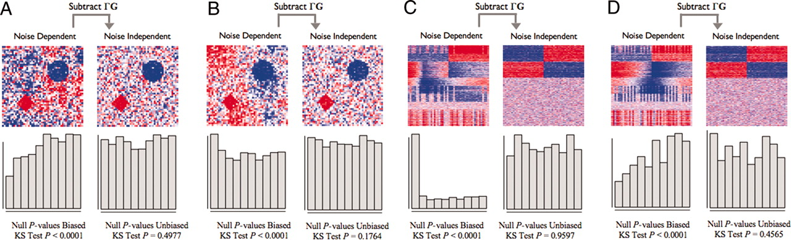
Simulated examples of multiple testing dependence.
Jeffrey T. Leek, and John D. Storey PNAS 2008;105:18718-18723
©2008 by National Academy of Sciences
Notes:
Simulated examples of multiple testing dependence. A and B consist of spatial dependence examples as simplified versions of that encountered in brain imaging, and C and D consist of latent structure examples as encountered in gene expression studies. In all examples, the data and the null P values are plotted both before and after subtracting the dependence kernel. The data are plotted in the form of a heat map (red, high numerical value; white, middle; blue, low). The signal is clearer and the true null tests' P values are unbiased after the dependence kernel is subtracted. (A and B) Each point in the heat map represents the data for one spatial variable. The two true signals are in the diamond and circle shapes, and there is autoregressive spatial dependence between the pixels. (A) An example where the spatial dependence confounds the true signal, and the null P values are anticonservatively biased. (B) An example where the spatial dependence is nearly orthogonal to the true signal, and the null P values are conservatively biased. (C and D) Each row of the heat map corresponds to a gene's expression values, where the first 400 rows are genes simulated to be truly associated with the dichotomous primary variable. Dependence across tests is induced by common unmodeled variables that also influence expression, as described in the text. (C) An example where dependence due to latent structure confounds the true signal, and the null P values are anticonservatively biased. (D) An example where dependence due to latent structure is nearly orthogonal to the true signal, and the null P values are conservatively biased.

Slide 13
Multiple Testing Dependence and Heterogeneity
A robust method for classification and regression on heterogeneity data can be evaluated under the context of the multiple tests with dependence.
Leek (2007) proposed Surrogate Variable Analysis (SVA) to estimate G in practice.
The SVA works pretty well when the unmodeled factor is independent with the modeled factors.

Slide 14
A potential problem in the SVA
When the data does not contains the rows which are only effected by the batches (unmodeled factors), SVA performs very pool.

Slide 15
Simulation Data 1

Slide 16
Simulation Data 2

